Slide 1
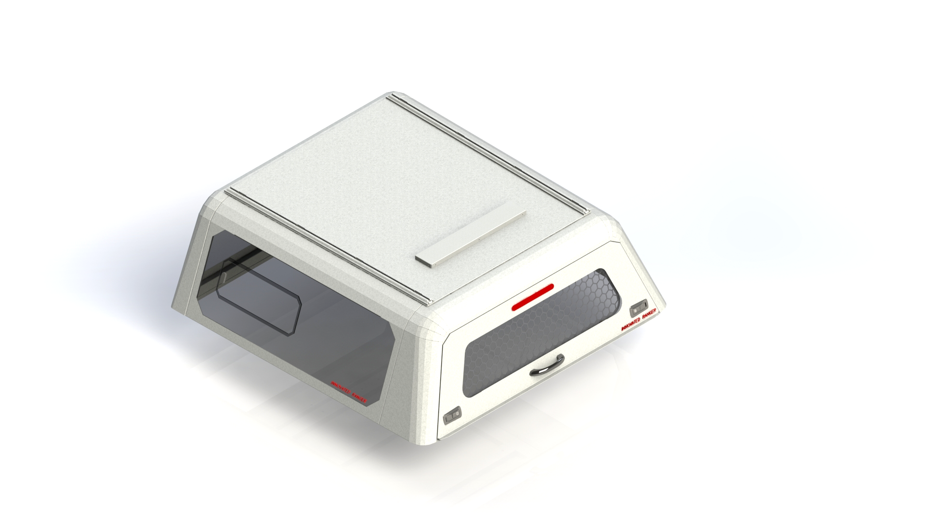
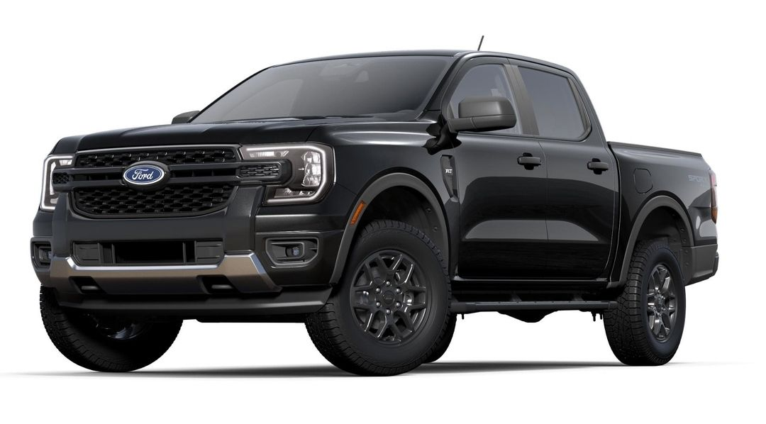
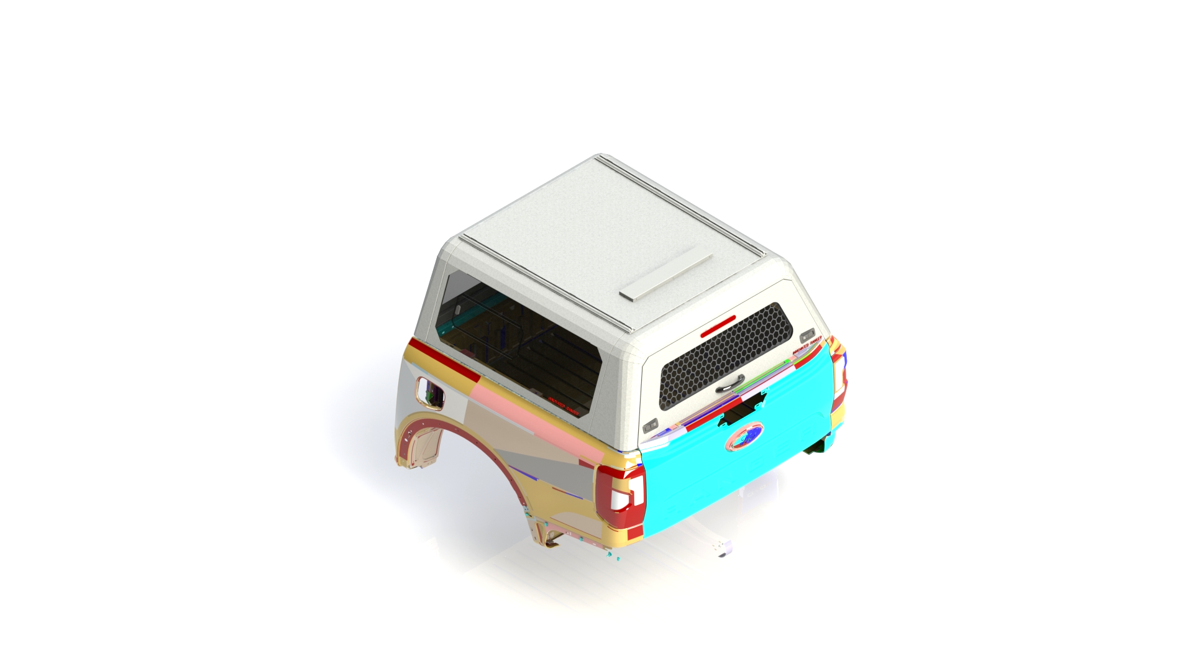
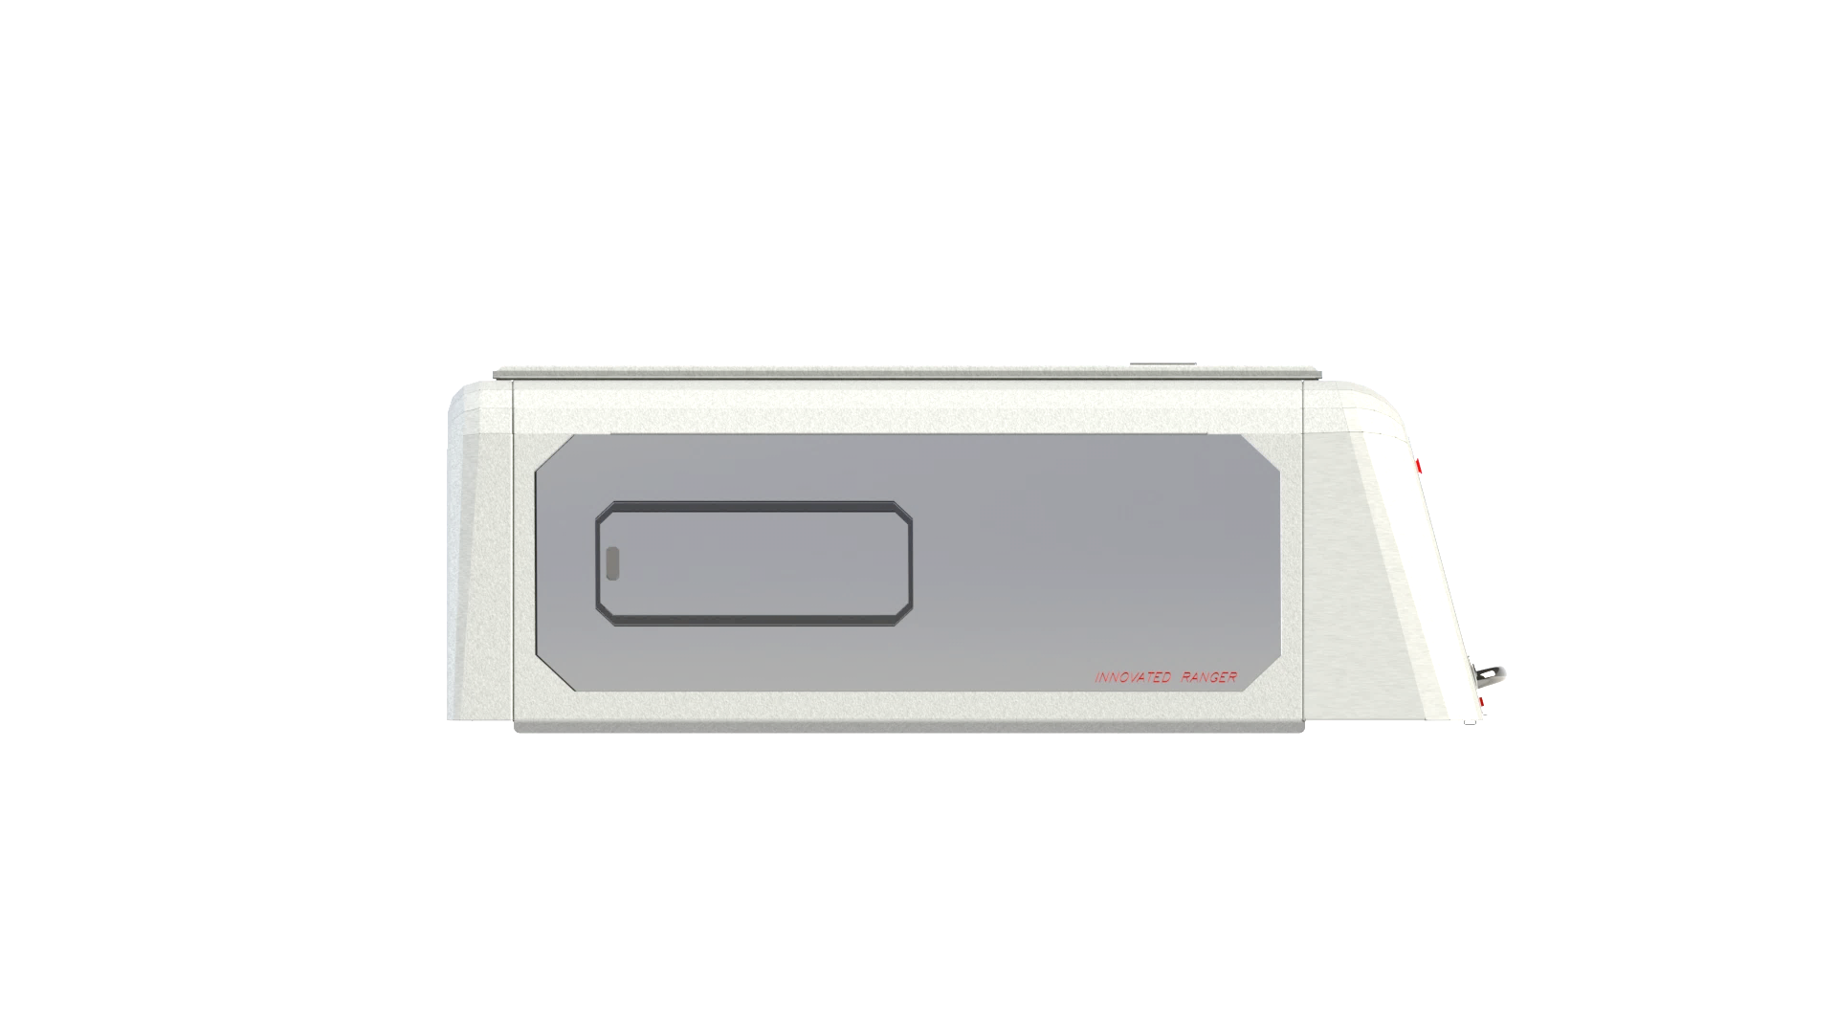
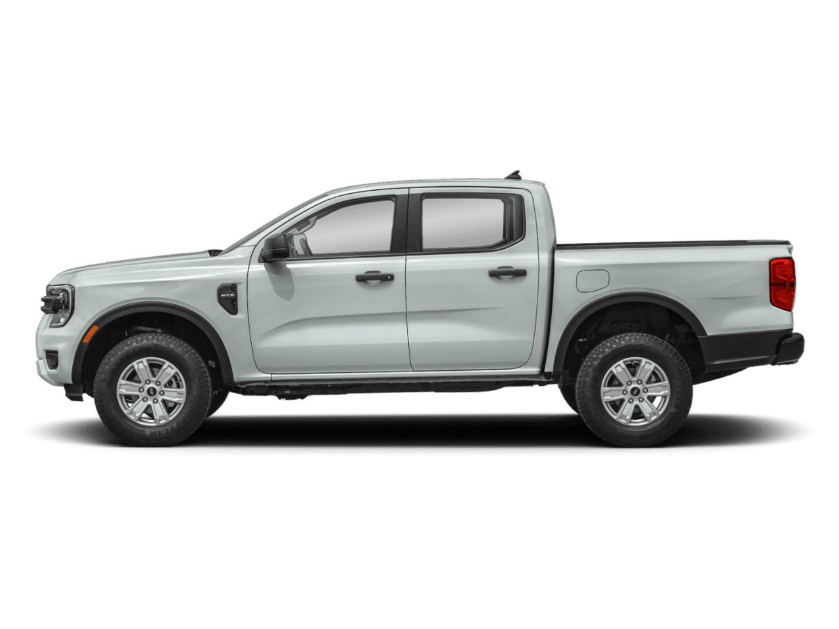

Canopies _ Design Concepts
25/03/2026
Technical data.
Material : Aluminium, Glass and rubber.
Finish : E- coating and Spray paints.
OEM CHMSL.
Window with Slider.
Locking System.
Air Vent System.
Product designed to comply to OEM standard.
ISO VIEW
SIDE VIEW
Pr Tech Grace Mata Futi

Slide 2
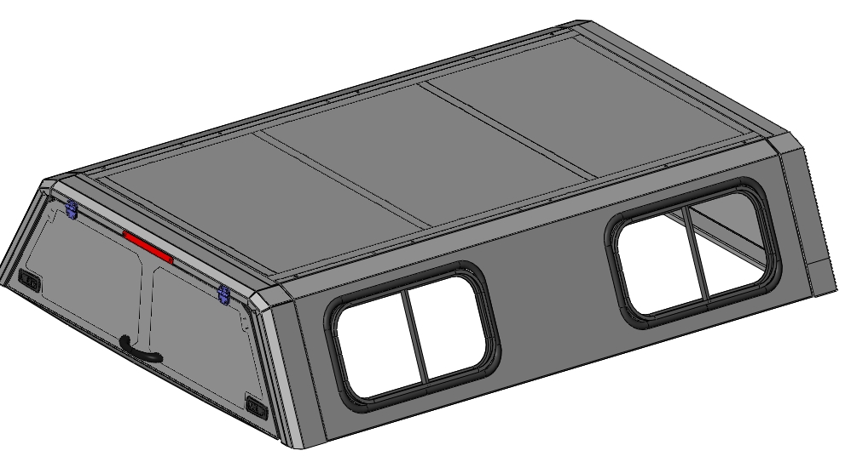
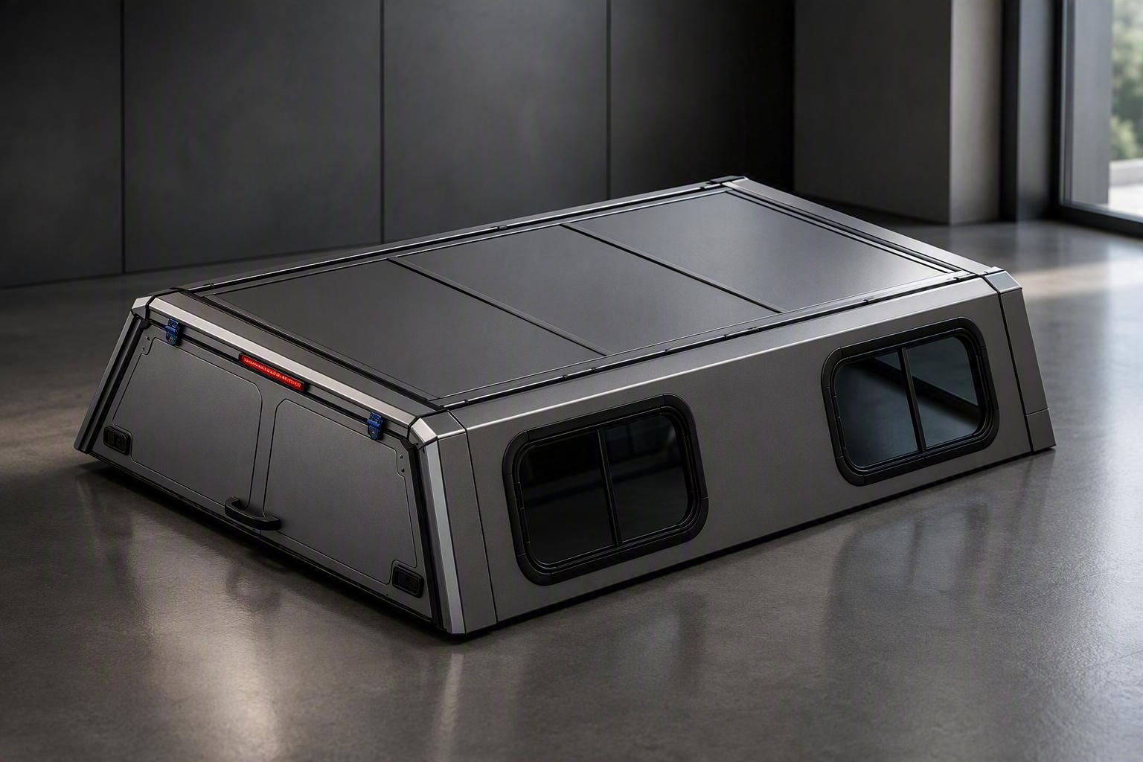
Canopies _ Design Concepts
25/03/2026
ISO VIEW
Technical data.
Material : Stainless steel, Glass and rubber.
Finish : E- coating and Spray paints.
OEM CHMSL.
Window with Slider.
Locking System.
Product designed to comply to OEM standard.
Pr Tech Grace Mata Futi

Slide 3
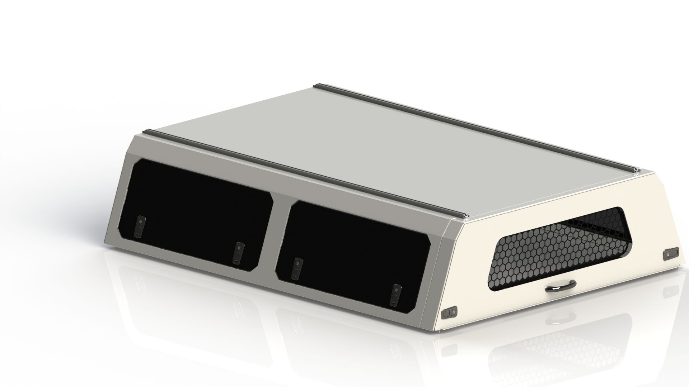
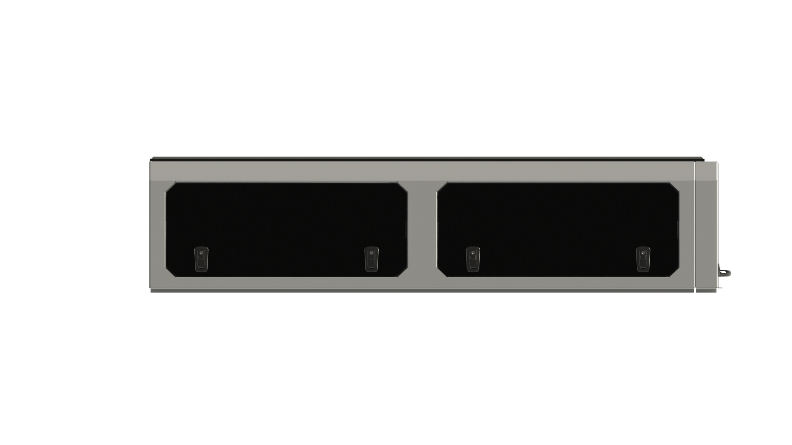
Canopies _ Design Concepts
25/03/2026
ISO VIEW
SIDE VIEW
Technical data.
Material : Stainless steel, Glass and rubber.
Finish : E- coating and Spray paints.
Window with Slider.
Locking System.
Product designed to comply to OEM standard.
Pr Tech Grace Mata Futi

